Slide 1
Job Gujarat
Hit Rachhadiya (92310133013) & Neel Raiyani (92310133019)
Capstone project

Slide 2
Table of content
Introduction
Problem Statement
Objectives
Technology Stack
Solution
Conclusion

Slide 3
Introduction
Job Gujarat is a web-based job portal created to solve our client’s problem of managing jobs through social media, which receives 300k–400k views and overwhelming calls and messages daily. The platform allows companies to post and manage jobs, jobseekers to create profiles, upload resumes, and apply easily, and the client to track everything in one place. It transforms the old social media process into a faster, organized, and scalable digital hiring system.

Slide 4
Problem statement
Our client was working as a middleman between jobseekers and companies using his social media page named Job Gujarat. His page gets around 300k–400k views on reels and too many calls every day. Because of this, it was becoming very difficult for him to manage everything only through calls and messages. Jobseekers had to wait for replies, and companies also faced issues in finding the right candidates quickly.
The main problem was that there was no proper system to handle job posts, applications, and communication in an organized way. Everything was manual, time-consuming, and hard to manage as the audience kept growing. That’s why there was a need for a digital platform that could make the whole process easy, fast, and manageable for both jobseekers and companies.

Slide 5
Objectives
Build a single platform where companies can post jobs and jobseekers can apply easily.
Reduce manual work and daily phone calls our client gets from social media.
Help jobseekers find and apply to relevant jobs quickly.
Help companies manage applications in one place (track status, view profiles, filter candidates).
Provide a smooth login and profile system so users can use the platform anytime.
Make the process fast, transparent, and organized for both sides.

Slide 6
Technology Stack
Frontend: React, Tailwind CSS, Framer Motion
Backend: Node.js/Express, Prisma ORM
Database/Storage: PostgreSQL + object storage (Supabase) for resumes and images.
Auth: Auth0 (secure OAuth, social login).
Payments: Razorpay (approval, posting, application fees) with verification.
Infra: Vercel for frontend, Render for backend.

Slide 7
solution
The system has three parts: Jobseeker, Employer, and Admin modules, each with their own dashboard and features.
Jobseekers: Browse jobs, apply, track applications, get recommendations & email updates.
Companies: Post/manage jobs, review applications, update status, make payments.
Admin: Monitor platform, manage users, prevent spam, track workflow.

Slide 8
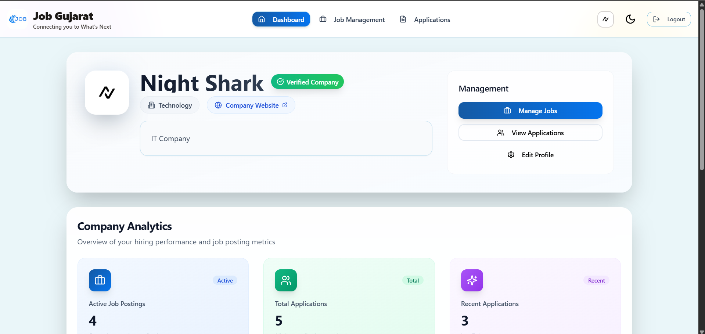
Company dashboard

Slide 9
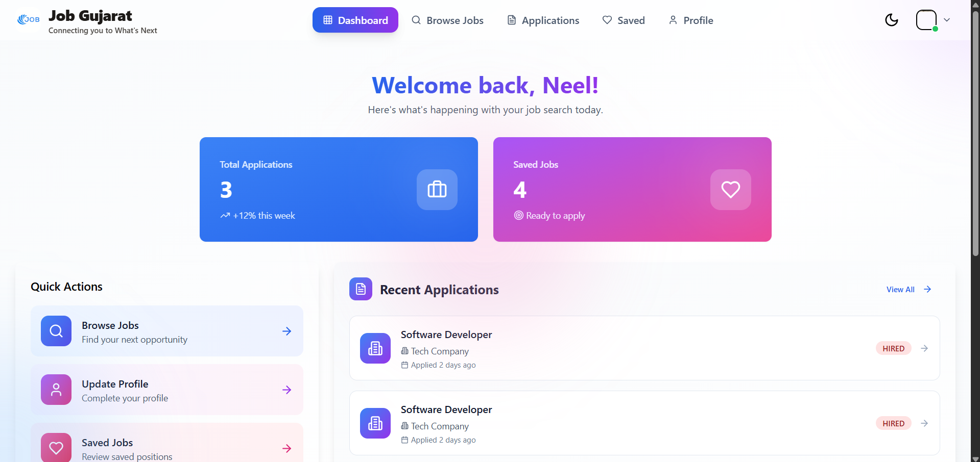
Jobseeker dashboard

Slide 10
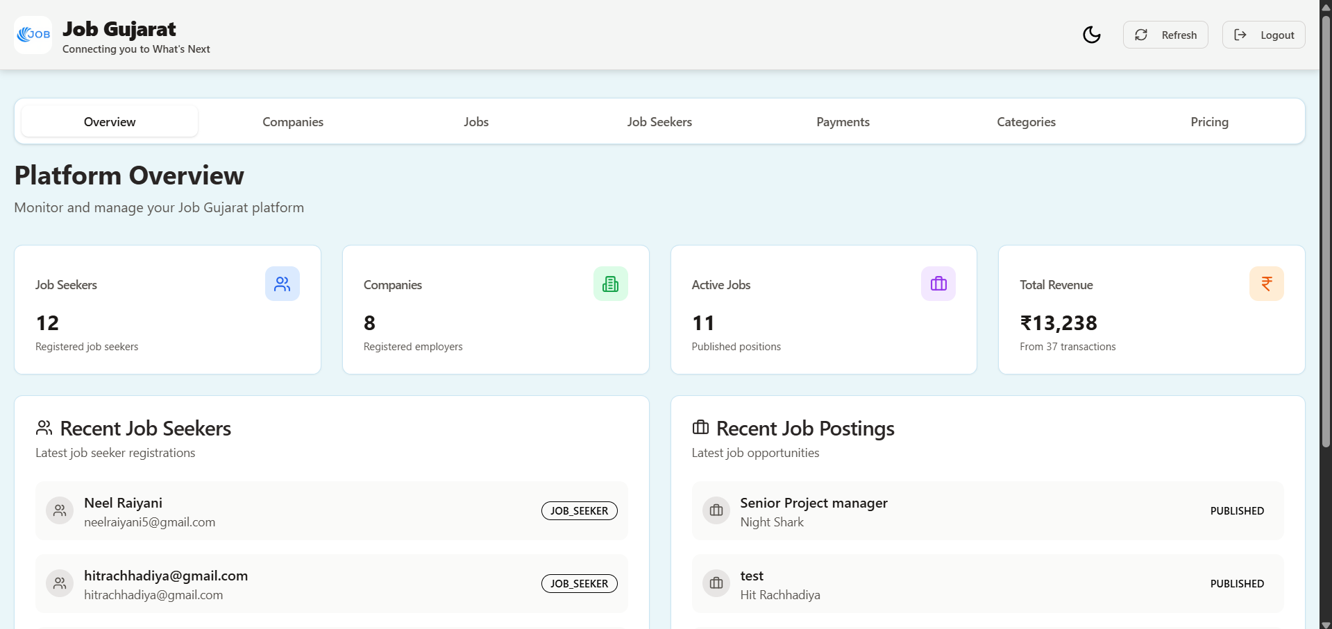
Admin Dashboard

Slide 11
conclusion
Our project directly solves our client’s real problem of handling too many job inquiries from social media. With this job portal, the process becomes simple, organized, and efficient for both companies and jobseekers. The system is technically feasible, cost-effective, and can easily scale in the future. It also matches the real market need, as Gujarat has a large number of jobseekers and companies, and the client already has a strong base of 300k–400k views on social media reels. This project makes recruitment faster, easier, and more professional for everyone involved.

